Slide 1

Rule-Based Multi-Robot Planning System
Student: Denisa-Gabriela Musteata

Slide 2
Table of contents
Project description
Knowledge representation
Facts Templates
Rule description
Testing and debugging
Results
Conclusions
1

Slide 3
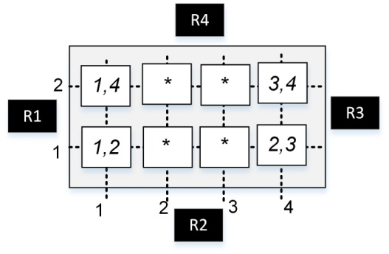
Project Description
Expert system implemented in CLIPS.
Coordinates four robots for manufacturing tasks.
Robots assign parts to goals based on availability and speed.
Handles transfers, collisions, and inventory rebalancing.
2

Slide 4
Knowledge Representation
Structured Facts (deftemplate) Information is stored as structured templates that define entities and their attributes.
Declarative Logic with Rules System behavior is defined through defrule which matches patterns in facts and performs actions (assert, modify etc.)
Slot-Based Representation Each entity has named slots: robot, goal etc.
Forward-Chaining Inference CLIPS uses data-driven reasoning: when facts match rule conditions, rules fire automatically, enabling dynamic response to state changes.
Modularity and Traceability Each rule performs a distinct task: assignment, validation, transfer, or warning.
3

Slide 5
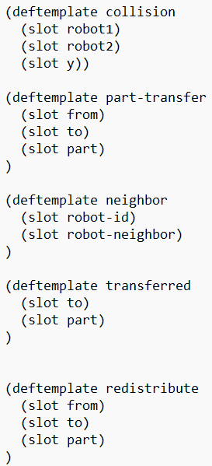
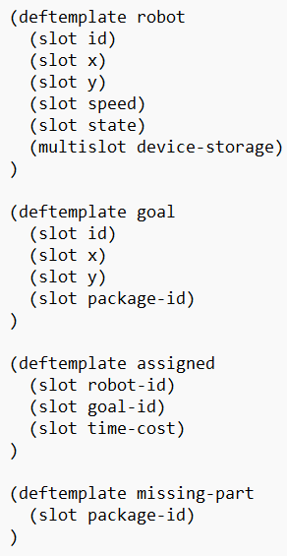
Fact Templates
(robot (id) (x) (y) (speed) (state) (device-storage ...))
(goal (id) (x) (y) (package-id))
(assigned (robot-id) (goal-id) (time-cost))
(missing-part (package-id))
(collision (robot1) (robot2) (y))
(part-transfer (from) (to) (part))
(neighbor (robot-id) (robot-vecin))
(transferred (to) (part))
(redistribute (from) (to) (part))
4

Slide 6
Rule Description
ASSIGN - OPTIMAL - GOAL | CHECK – MISSING - PART | DETECT - COLLISION
IF a goal is unassigned AND a free robot has the required part THEN calculate time-cost based on distance and speed assign robot to goal mark robot as busy | IF a goal requires a part AND no robot has that part THEN declare that the part is missing print warning | IF two robots are assigned to goals AND those goals are on the same Y coordinate AND their X positions are adjacent or equal THEN flag a collision print warning
5

Slide 7
Rule Description
INITIATE – PART - TRANSFER | REDISTRIBUTE – AFTER - GOALS
IF a robot lacks a needed part AND a neighbor has it AND the transfer hasn’t happened yet THEN remove the part from the neighbor add the part to the current robot log the transfer print transfer confirmation | IF there are no remaining goals AND one robot has significantly more parts than another THEN select a part from the robot with excess redistribute it to the robot with fewer log the redistribution
6

Slide 8
Testing and Debugging
Rule Testing
Hard to handle cases testing
Inspection after run
Scenario Validation
Prioritization
7

Slide 9
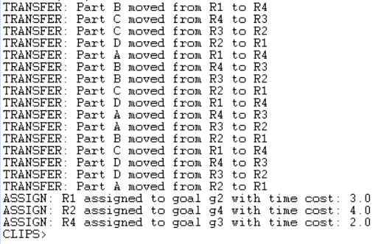
Results
Successful Robot-Goal Assignment
Dynamic Part Transfers
Collision Detection Functionality
Post-Mission Redistribution
Consistent Knowledge Base Updates
8

Slide 10
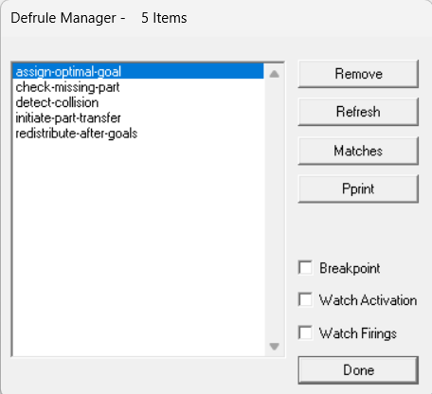
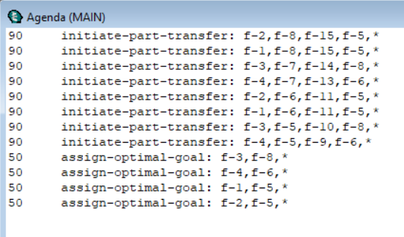
Results
9

Slide 11
Conclusion
Rule-based system manages multi-robot coordination.
Uses structured facts and modular rules.
Lays foundation for smart manufacturing systems.
Supports extension to dynamic or real-time contexts.
10

Slide 12
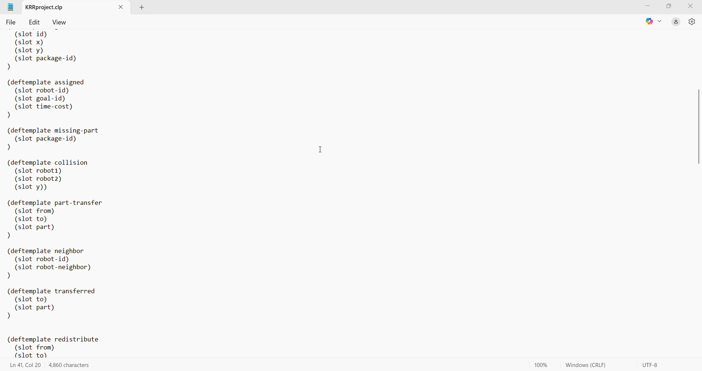
LIVE DEMO
11

